Slide 1

Binaural Rendering of Ambisonics B-format
College of Engineering, Pune
Department of Computer Engineering and
Information Technology
Btech Project Presentation by Anupam Godse (111408016)
Project Guide:- Dr. V.K. Pachghare
Project in collaboration with NVIDIA

Slide 2
Introduction
About Ambisonics
Stores directional information
No predefined speaker layout required
Usage for real time applications like gaming
Ambisonics B-format
Widely used to store first order ambisonics information
4 channels
W : Omni directional sound pressure.
X : Front-Back direction with respect to the listener
Y : Left-Right direction with respect to the listener
Z : Up-Down direction with respect to the listener

Slide 3
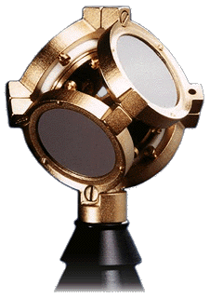
Introduction
Encoding Ambisonics
Using special surround sound microphone (tetrahedral with 4 cardoids)
Storage
Widely used Ambisonics B-format
Decoding Ambisonics
Using decoder to render it over any on the fly defined speaker configuration

Slide 4
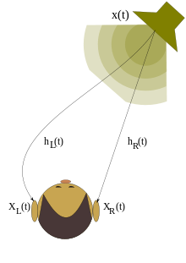
Introduction
Binaural Rendering
Converting ambisonics decoded output into headphone outputs by using Head Related Transfer Functions.

Slide 5
Introduction
Head Related Transfer functions
To adjust Interaural time and intensity differences.
CIPIC HRTF Database
45 Subjects
25 Azimuths
50 Elevations

Slide 6
Traditional Approaches
Required predefined layout of speakers
Information was stored in form of channels
For ex 5.1, 7.1
No consideration of height dimension
Poor audio effects
Listener needed to be at a particular position to get intended effects
Sweet spot

Slide 7
Advantages of Ambisonics Approach over traditional approaches
No predefined speaker layout needs to be defined
Ambisonics stores the directional information of sound and not the channel information
Listener need not to be at particular place
Head tracking can be used to track users head movements
Can be used in variety of applications
High end real time gaming
360 degree videos
Other VR applications

Slide 8
Problem Defination
Design a system which takes ambisonics B-format (4 channels) as an input and generates output for headphones i.e. binaural output (2 channels). For real time applications, it should take information from the head tracking devices and generate the output accordingly.

Slide 9
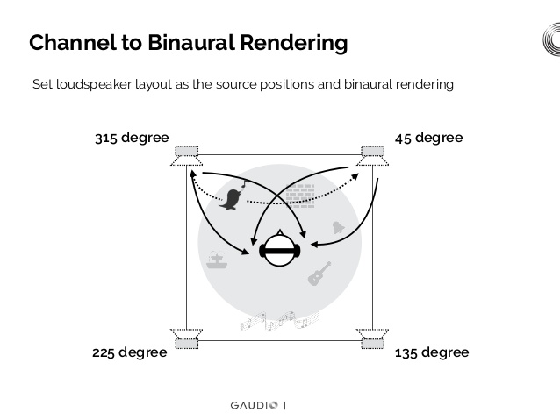

Slide 10
Literature Survey
Traditional Approaches
Michael Gerzon has criticized the traditional surround sound approaches and also has given the criteria for the design of the surround sound systems [1].
The traditional quadraphonic systems never gave the optimum results. The aim of these systems were to duplicate the effect of ’original’ 4 track tape, but they failed to do so [3].
Peter Fellgett said that the existing techniques were inadequate in number of ways like they restricted to fixed number of speakers and the production needs of 4 channels to be available [3].
They suffered from ’hole in the middle’ effect and if the situation is less ideal it becomes unusable. For example when the room is non-square or when the listener is not at the sweet spot [5].

Slide 11
Literature Survey
An Ambisonics approach
While traditional technique of surround sound had its limitations and disadvantages, Ambisonics, developed in the early 1970s by Peter Fellget [3] and Michael Gerzon [4] is a way of recording and reproducing surround sound in both horizontal and vertical surround, which gave more immersive experience to the listener and provided full upward compatibility to any number of loudspeakers in the user defined configuration.

Slide 12
Literature Survey
Virtual Speakers array
Convincing binaural sound reproduction requires to filter the sound sources with the HRTFs. Moreover incorporation head-tracking further improvements in localization.
Also increasing large number of virtual sound sources helps [6]. Using the finite number of speakers gives good approximation of the original sound field over a finite area.

Slide 13
Literature Survey
Development of Binaural System
After rendering over the virtual speaker array HRTFs are used to filter these signals of each speaker and converting mono to left and right signals for each speakers.
When these all signals are superimposed we get a single left and single right (Binaural) headphone output signals.
Further using head tracking to take into account the head rotation will further improve the effects [6 7 10].

Slide 14
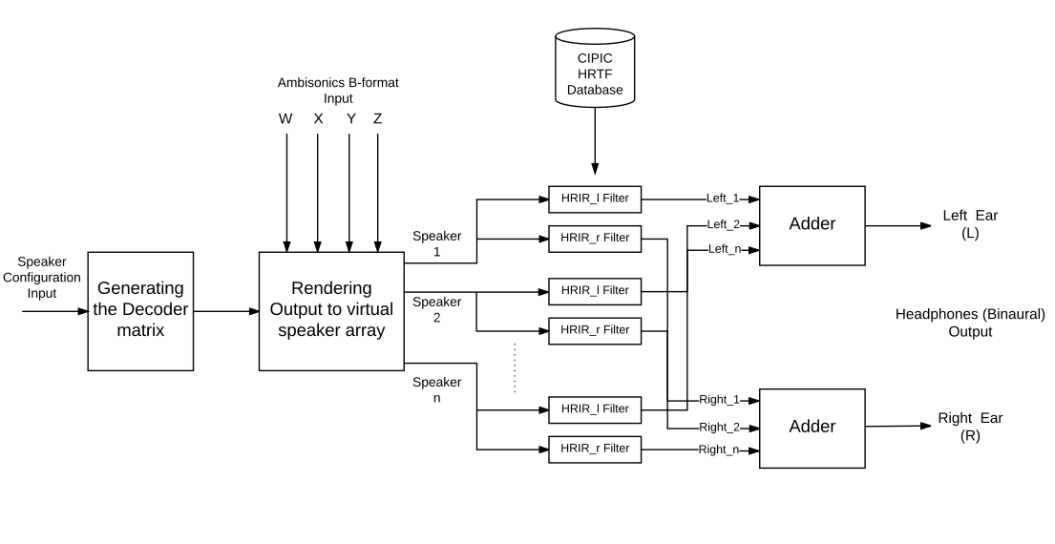
Proposed System Architecture:Diagram

Slide 15
Proposed System Architecture: Explaining basic blocks
Generating the Decoder matrix:
The speker configuration (the azimuth and evevation for each speaker) will be taken as input and this function will generate a decoder matrix.
Rendering output to virtual speaker array:
This function will take the 4 channels
(W, X, Y and Z) and the decoder matrix as inputs and generate a mono output for each speaker of the speaker array.

Slide 16
Proposed System Architecture: Explaining basic blocks
The Cipic HRTF Database:
This is the Database which has the HRIR pairs(left and right) for the range of azimuth and elevation pairs for each of the speakers.
Adder: Superimposing
This is a simple adder which will add all the outputs from each HRIR-l and HRIR-r filters and generate a single left and right final binaural audio.

Slide 17
Requirements Specification
Functional Requirements
The system must take an ambisonics B-format (4 channel) file as input and give 2 channel output.
The head-tracking device inputs should be taken into consideration for real time applications and output should be generated accordingly.
It should work for 360 degree videos, real-time high-end gaming and other Virtual Reality applications.

Slide 18
Requirements Specification
Non-Functional Requirements
Usability: The system should be easy to integrate with any Virtual reality application.
Performance: The system should be efficient to provide the output by reducing the number of computations.
Latency: The latency must be very low to be suitable for real time applications.

Slide 19
Requirements Specification
Hardware Requirements
RAM: System should have minimum 2 GB RAM.
Hard Disk: System should have minimum 40 GB of free space.
Head tracking device: The user should have a head tracking device to connect to be system to give head rotation inputs for real time applications.
Graphics Card: System should have a sufficient graphics card to support the required Virtual Reality Application.

Slide 20
Requirements Specification
Software Requirements
C++ Platform
MATLAB: 5x or higher version
CIPIC HRTF Database

Slide 21
Conclusion
Plenty of advantages of using ambisonics approach
Can be used for real time applications
Better immersive audio effects
Eliminating hardware dependency on loudspeaker requirements
Usable for mobile applications

Slide 22
Timeline
Stage | Compeltion
Literature Survey | Mid October – Completed
System Architecture | Mid November – Completed
Proof of Concept | December End – Completed
Drafting Paper | Mid February – Completed
Working Application Primary | February End – Completed
Optimizations | March End – To be done
Adding rotation and testing | Mid April – To be done

Slide 23
References
Michael Gerzon ‘Surround Sound Psychoacoustics’WirelessWorld, December 1974, pp 483-6, www.ai.sri.com/ajh/ambisonics/wireless-world-gerzon-12-1974.pdf.
Michael Gerzon ‘What’s Wrong with Quadraphonics?’ Studio Sound May 1974
Peter Fellgett. ’Ambisonics Part one: General system description’, August 1970, pp338-342
Gerzon, M.A. ’Ambisonics Part two: Studio Techniques’, STUDIO SOUND, August 1975. pp24 - 30, https://www.michaelgerzonphotos.org.uk/articles/Ambisonics
Gerzon M.A. ’Ambisonics in multichannel broadcasting and video.’ J. Audio Eng. Soc. 1985, 33 (11) pp.859-8711549-4950
Noisternig M., Musil T., Sontacchi A., Holdrich R. ‘A 3D Real Time Rendering Engine for Binaural Sound Reproduction’, Proceedings of the 2003 International Conference on Auditory Display, Boston, MA, USA, 6-9 july, 2003

Slide 24
References
Cedric Yue, Teun de Planque, ‘3-D Ambisonics experience for Virtual Reality’, Stanford University, 2017
Noisternig M., Musil T., Sontacchi A. Robert Holdrich, ‘3D Binaural Sound Reproduction using a Virtual Ambisonic Approach’, VECIMS 2003 - lntemafional Symposium on Virtual Environments, Human~Compuler Interfaces, and Measurement Systems Lugann, Switzerland, 27-29 July 2003, pp 174-178, IEEE, Washington (2003)
Algazi V.R., Duda R.O., Thompson D.M., Avendano C. ‘The ClPlC HRTF Database’, in Proc IEEEWorkhop on Applicalions of Six. Proc lo Audio and Elecfrmcou~ficpsp, 9-102, NY, 2001

Slide 25
Thank You!

Slide 26
Questions?

